Slide 1
Wasp Production Project
By: Daniel Han

Slide 2
Background Information
Biocontrol: When we use natural enemies to reduce invasive species population, we refer to the natural enemies as “biological control agents”. Female wasps lay their eggs inside pest eggs and the developing parasitoid larvae kill pest eggs by feeding inside the pest egg.
The objective is to test if some plants can increase reproduction of wasps so as to control the pest population.
There are three different treatment:
– Buckwheat (BW)
– No plant/water only (W)
– Vetch (V)

Slide 3
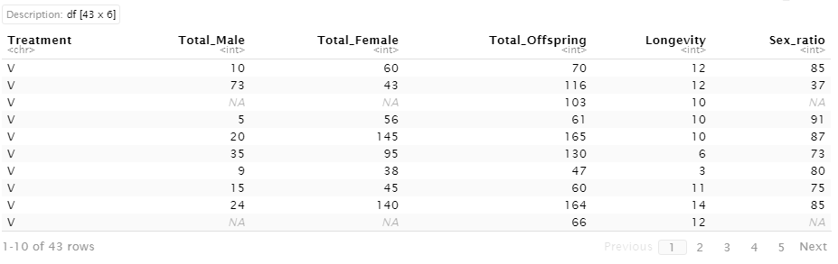
Data Table

Slide 4
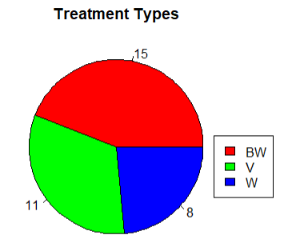

Descriptive Analysis: Treatment Types

Slide 5
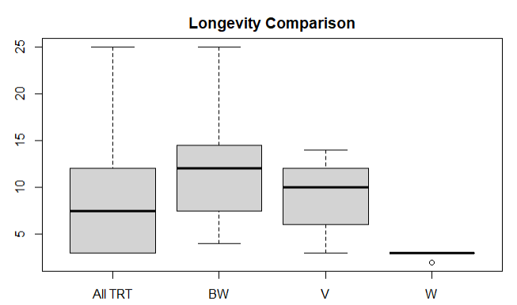
Descriptive Analysis: Longevity

Slide 6
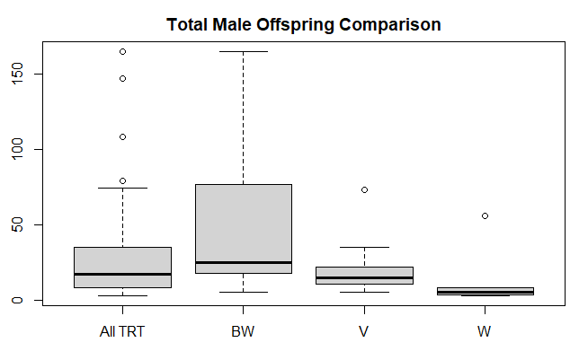
Descriptive Analysis: Total Male Offspring

Slide 7
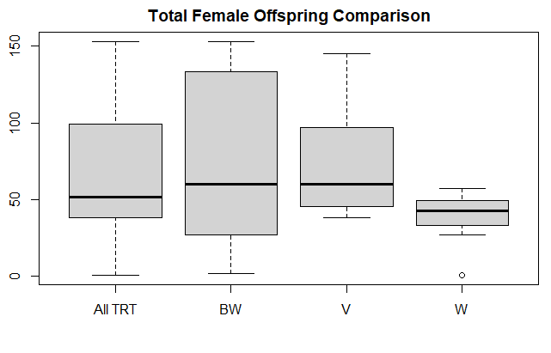
Descriptive Analysis: Total Female Offspring

Slide 8
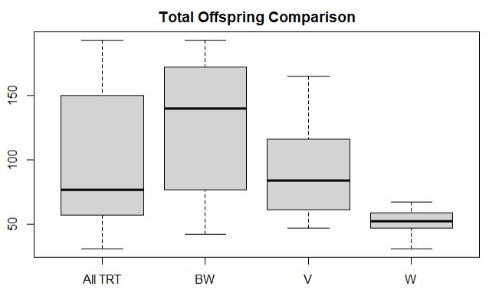
Descriptive Analysis: Total Offspring

Slide 9
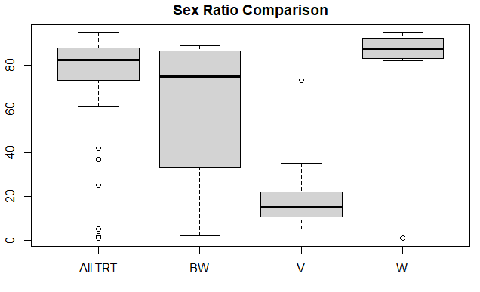
Descriptive Analysis: Sex Ratio

Slide 10
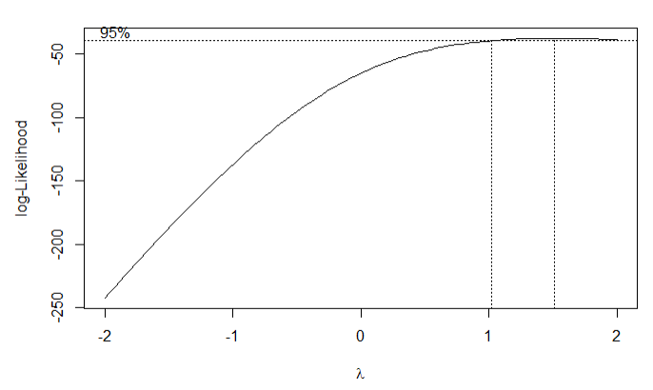
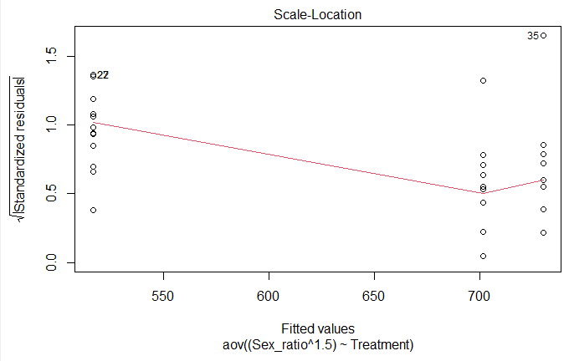
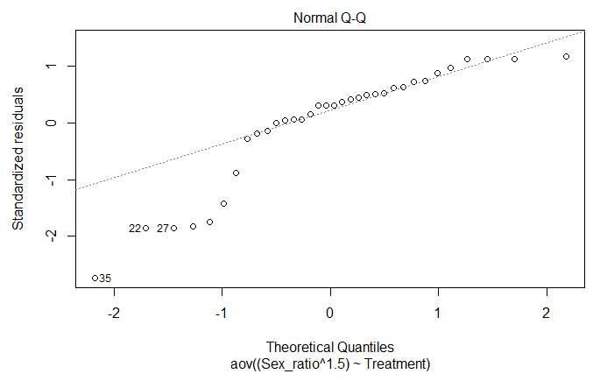
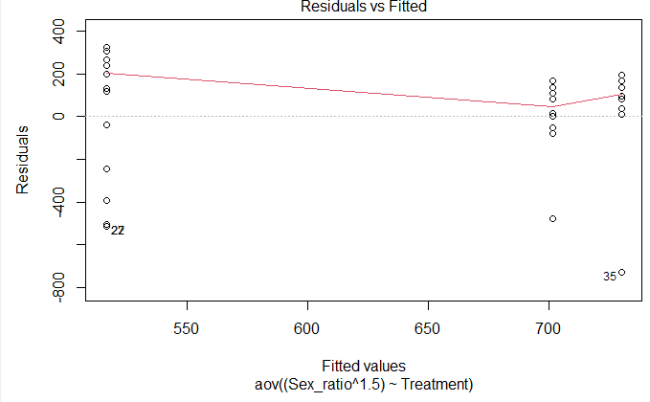
Data Analysis: One way ANOVA (Sex Ratio)
We have to check the assumptions of independence, normality and constant variance. In order to meet all the assumptions, I transformed the variable by finding λ with boxcox. Then pugging in λ into y^λ to transform the data. In this case, λ = 1.5.

Slide 11

Data Analysis: One way ANOVA (Sex Ratio)
Since the treatment effect is insignificant, we don't need to do a post hoc test and can conclude that that treatment is insignificant to sex ratio.

Slide 12
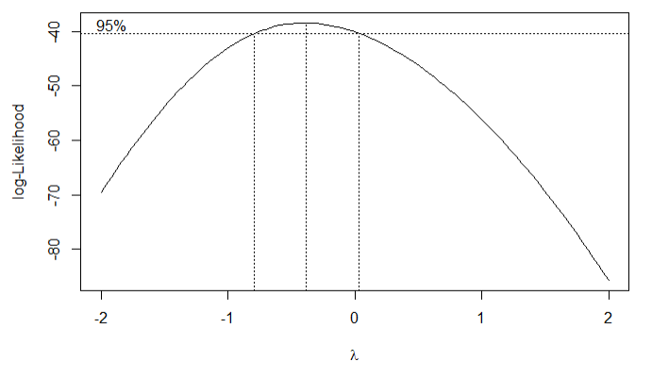
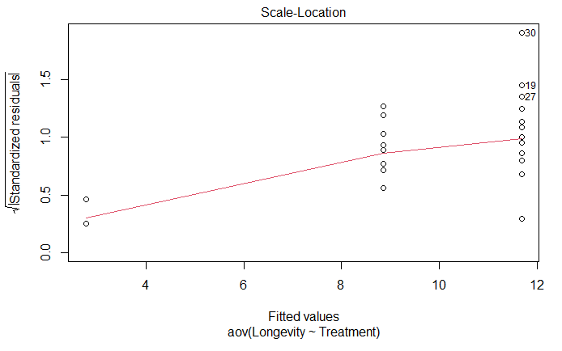
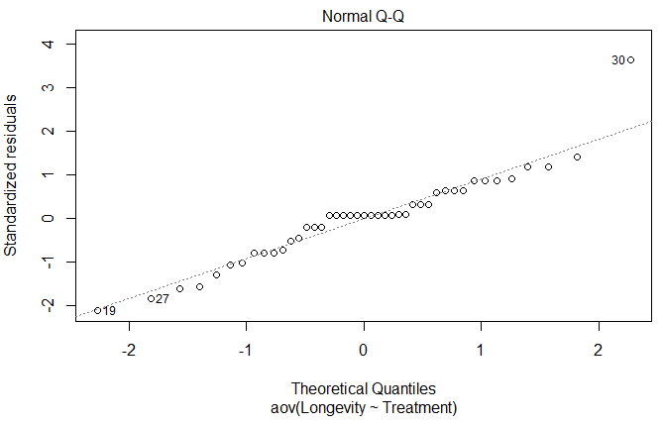
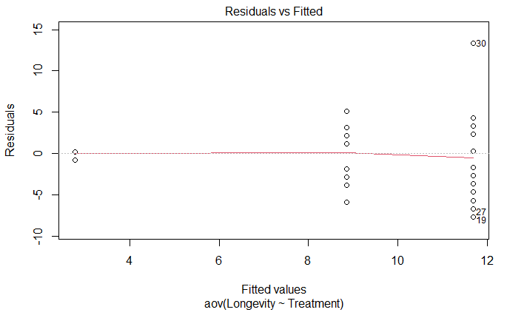
Data Analysis: One way ANOVA (Longevity)
We have to check the assumptions of independence, normality and constant variance. In order to meet all the assumptions, I did not need to transform the data for this variable.

Slide 13

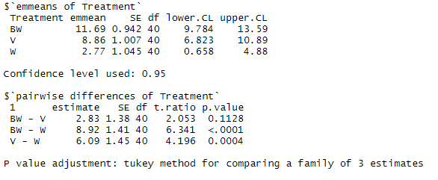
Data Analysis: One way ANOVA (Longevity)
P- value < 0.05, I can conclude that the treatment effect is significant total female offspring. I need to perform a post hoc test using Tukey adjustment to determine which mean differences are significant, and which are not.
Based on the Tukey , I can conclude that W-BW (Water only - Buckwheat) and W-V (Water only - Vetch) are significantly significant while BW - V (Buckwheat - Vetch) is insignificant when affecting longevity.

Slide 14
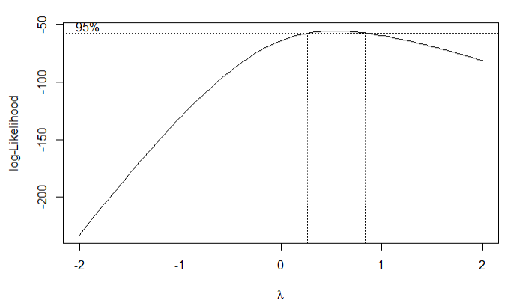
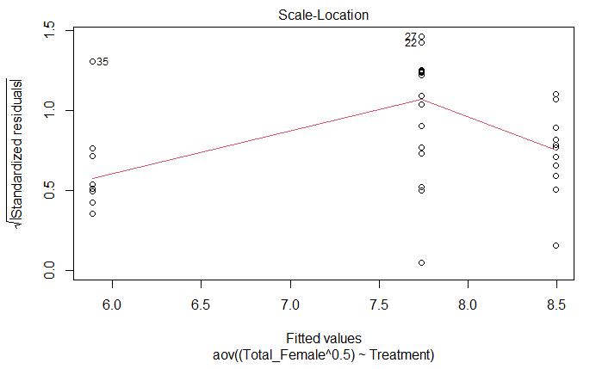
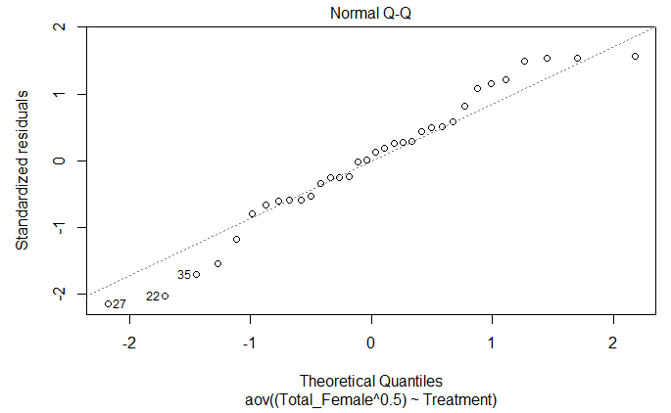
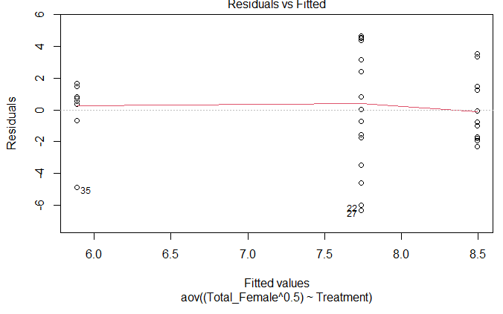
Data Analysis: One way ANOVA (Total Female Offspring)
We have to check the assumptions of independence, normality and constant variance. In order to meet all the assumptions, I transformed the data by finding λ with boxcox. Then pugging in λ into y^λ to transform the data. In this case, λ = 0.5

Slide 15

Data Analysis: One way ANOVA (Total Female Offspring)
Since the treatment effect is insignificant, we don't need to do a post hoc test and can conclude that that treatment is insignificant to total female offspring.

Slide 16
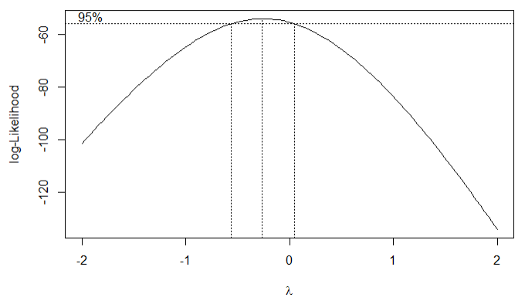
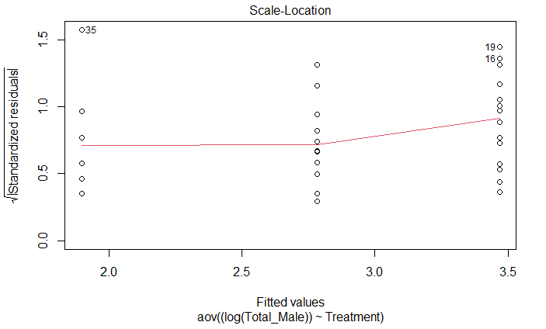
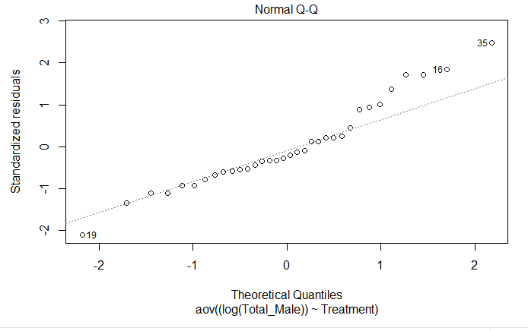
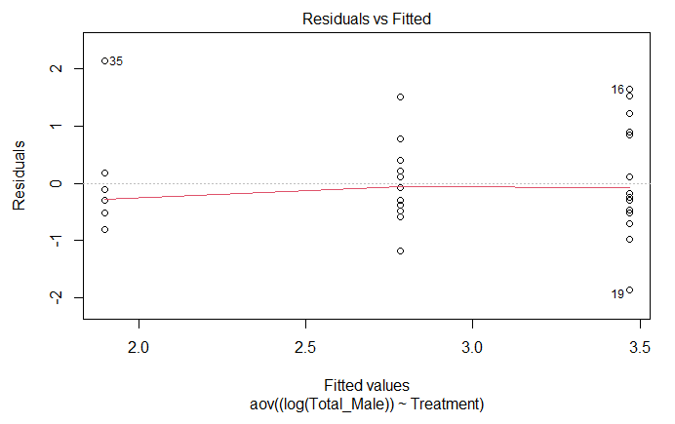
Data Analysis: One way ANOVA (Total Male Offspring)
We have to check the assumptions of independence, normality and constant variance. In order to meet all the assumptions, I transformed the data by finding λ with boxcox. I ended up doing a log transformation for the data in order to meet the assumptions.

Slide 17

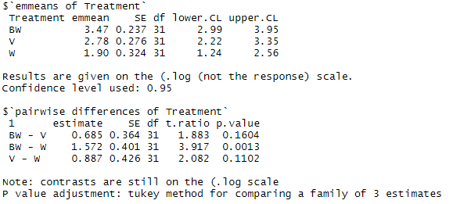
Data Analysis: One way ANOVA (Total Male Offspring)
P- value < 0.05, I can conclude that the treatment effect is significant total offspring. I need to perform a post hoc test using Tukey adjustment to determine which mean differences are significant, and which are not.
Based on the Tukey test, I can conclude that W-BW (Water only - Buckwheat) is significant while BW - V (Buckwheat - Vetch) and W-V (Water only - Vetch) are insignificant when affecting total male offspring.

Slide 18
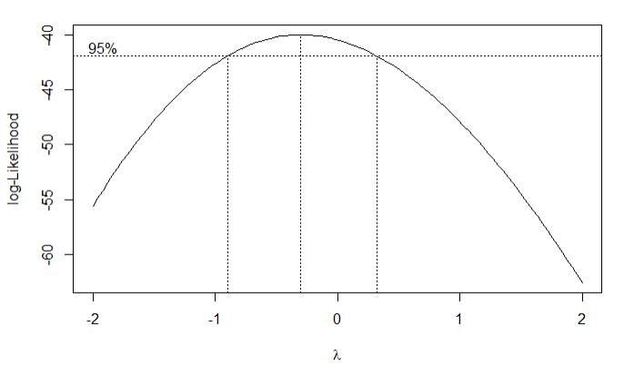
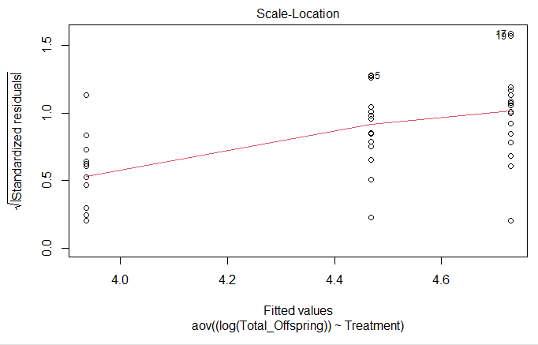
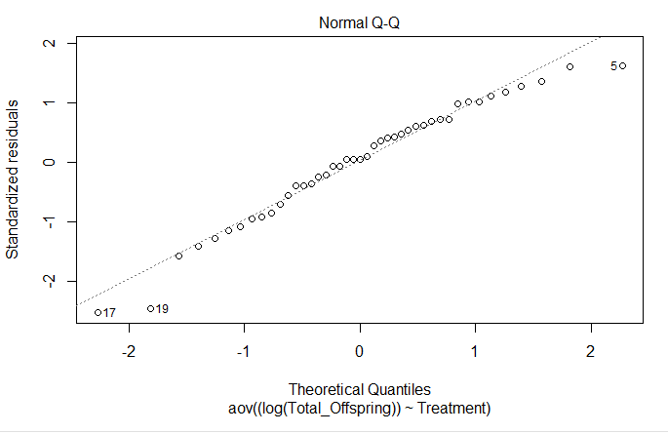
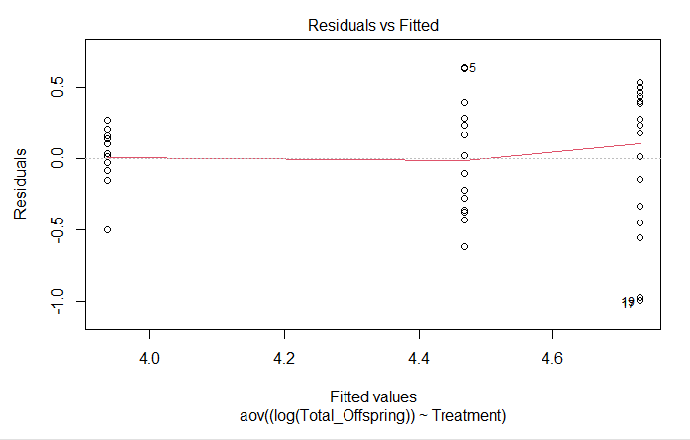
Data Analysis: One way ANOVA (Total Offspring)
We have to check the assumptions of independence, normality and constant variance. In order to meet all the assumptions, I transformed the variable with boxcox. I used log to transform the variable in order to meet the assumptions.

Slide 19

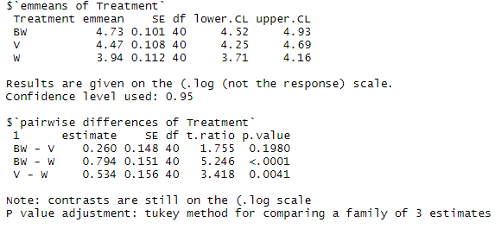
Data Analysis: One way ANOVA (Total Offspring)
P- value < 0.05, I can conclude that the treatment effect is significant total offspring. I need to perform a post hoc test using Tukey adjustment to determine which mean differences are significant, and which are not.
Based on the Tukey test, I can conclude that W-BW (Water only - Buckwheat) and W-V (Water only - Vetch) are significant while BW - V (Buckwheat - Vetch) is insignificant when affecting total offspring.

Slide 20
Data Analysis: Summary
One-Way Anova Test
Insignificant Variables : Total Female Offspring and Sex Ratio
Significant Variables : Total Male Offspring, Total Offspring, and Longevity
Post Hoc Test (means comparison and Tukey) on significant variables
BW - V (Buckwheat - Vetch): Insignificant for Total Male Offspring, Total Offspring, and Longevity
BW - W (Buckwheat - Water only): Significant for Total Male Offspring, Total Offspring, and Longevity
V - W (Vetch - Water only) : Significant for Total Offspring, and Longevity
Based on the results, I conclude that the treatments can increase the reproduction of wasp with more effect on male wasp offspring, total offspring, and the longevity of those offspring’s.

